Slide 1
ShanghaiTech University
EE 115B: Digital Circuits
Fall 2021
Lecture 13
Hengzhao Yang
November 16, 2021

Slide 2
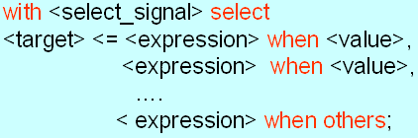
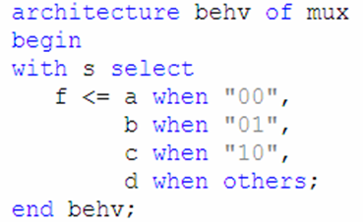
Concurrent: selected signal assignment
A signal can be assigned one of several values based on a selection criterion.
Syntax
Example

Slide 3
Concurrent: selected signal assignment
Keywords: with-select-when
  <select_signal> can be an internal signal or an input port
  <target> can be an internal signal or an output port
  <value> is one possible value of <select_signal>
  when others is required if not all values of <select_signal> are covered

Slide 4
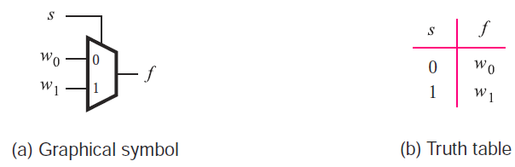
Example: 2-to-1 mux (ch. 6)
Truth table

Slide 5
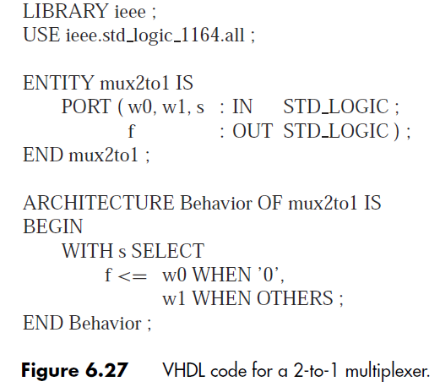
Example: 2-to-1 mux

Slide 6
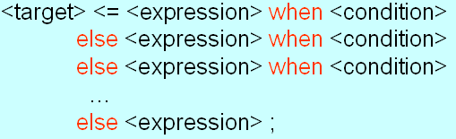
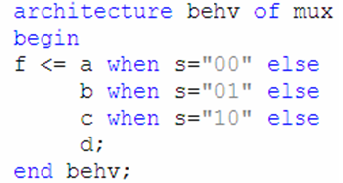
Concurrent: conditional signal assignment
A signal can be assigned one of several values based on a condition.
Syntax
Example

Slide 7
Concurrent: conditional signal assignment
Keywords: when-else
  <target> can be an internal signal or an output port
  <expression> operates on internal signals or input ports when <condition> is true
  Last else branch covers all missing conditions

Slide 8
Example: 2-to-1 mux (ch. 6)
Truth table

Slide 9
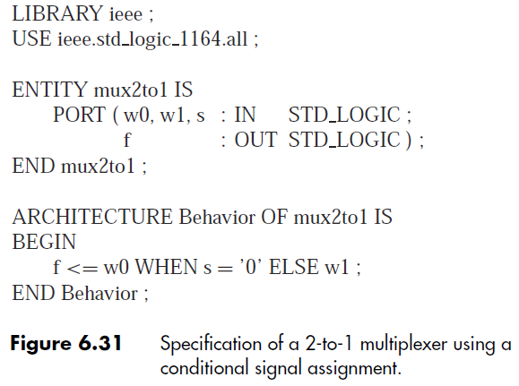
Example: 2-to-1 mux

Slide 10
VHDL design description
Behavioral
  Model a circuit based on its functionality
Structural
  Build a complex circuit based on components (lower-level circuits)

Slide 11
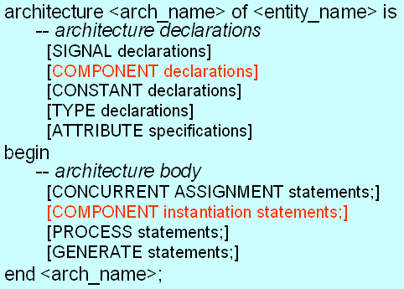
Component
An entity defined in one source code file can be used as a component in another source code file.
Requires component declaration and component instantiation statements.

Slide 12
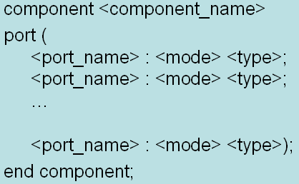
Component: declaration
Syntax
Example
  <component_name> must be the name of the entity to be used.

Slide 13
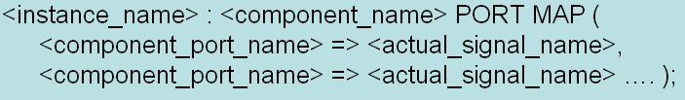
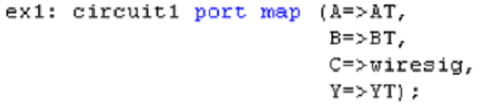
Component: instantiation
Syntax 1: positional association
Syntax 2: named association
Example

Slide 14
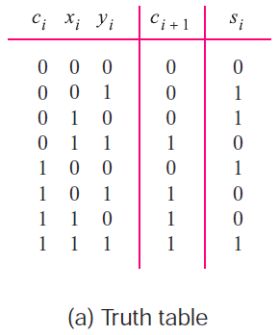
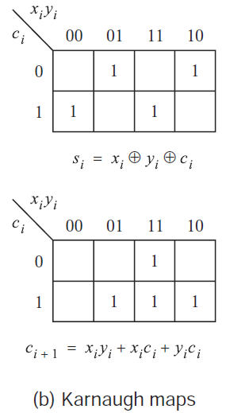
Example 1: 4-bit full adder
Truth table for 1-bit full adder

Slide 15
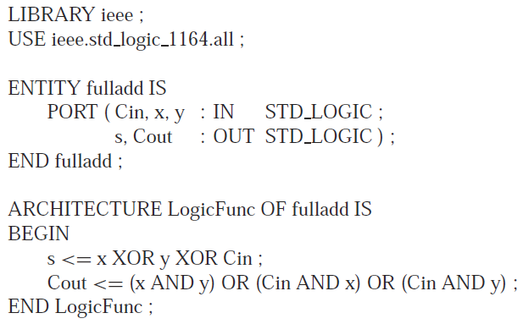
Example 1: 4-bit full adder
VHDL code for 1-bit full adder

Slide 16
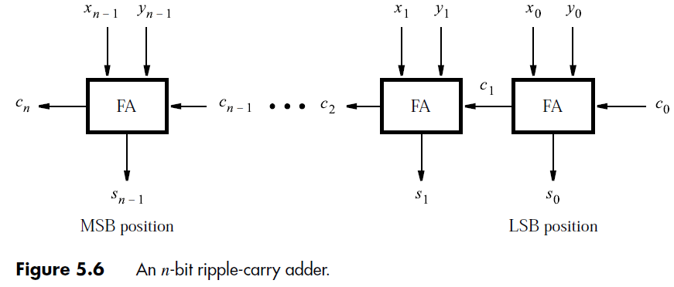
Example 1: 4-bit full adder
General form: n-bit full adder

Slide 17

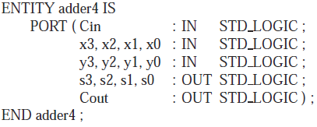
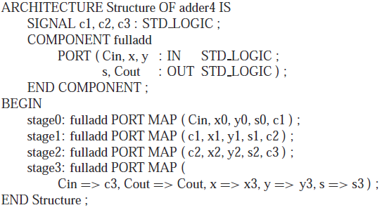
Example 1: 4-bit full adder

Slide 18
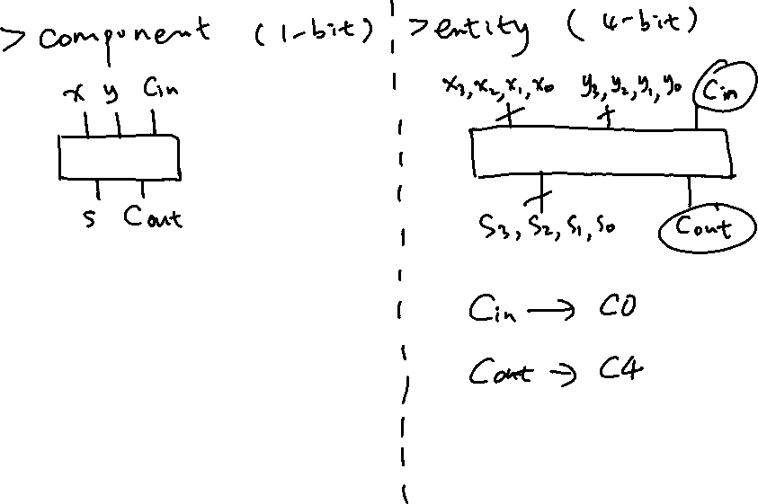
Component vs. Entity

Slide 19
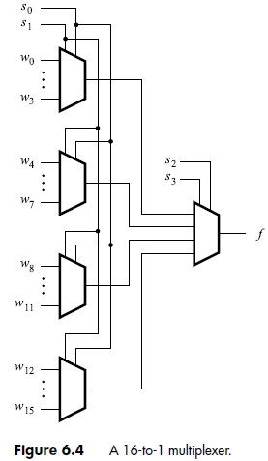
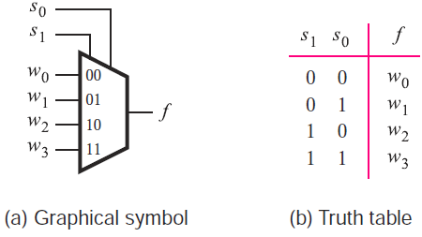
Example 2: 16-to-1 mux
Truth table for 4-to-1 mux

Slide 20
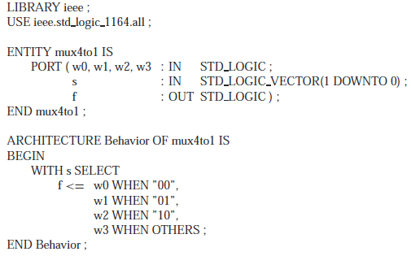
Example 2: 16-to-1 mux
VHDL code for 4-to-1 mux

Slide 21

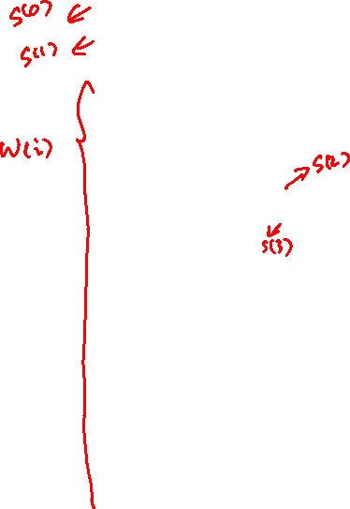
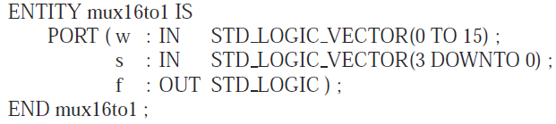

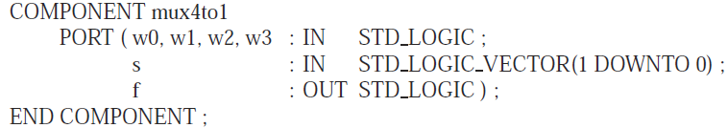
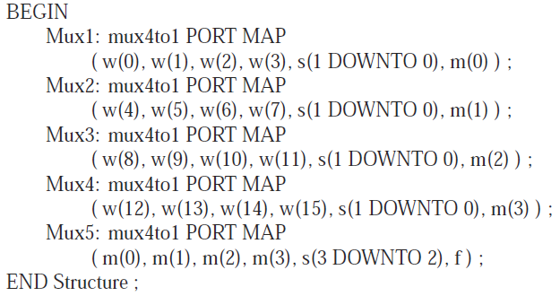
Example 2: 16-to-1 mux

Slide 22
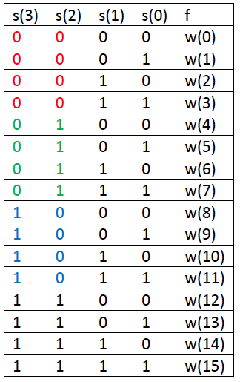
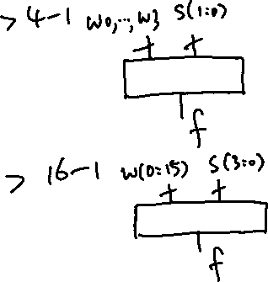
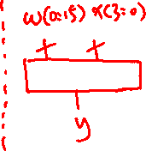
16-to-1 mux: operation
Select signal
  s(3)s(2): select block
  s(1)s(0): select input

